Slide 1
Crossing Thresholds Module 5
Positioning for Success

Slide 2
Agenda
Morning
Individual progress updates
Thinking about what you want
Career goal refresh
Peer feedback in Peer Groups
Raising your profile
Afternoon
Developing resilience
Mentor panel - tips for going forward
Review and close

Slide 3
Thinking about what you want
What have you learned about focusing on what you want?
What have you learned about yourself?

Slide 4
Career Planning - Milestones
What I want
Milestone 1:
By When:
Milestone 2:
By When:
Milestone 3:
By When:
My relevant current situation
Milestone 4:
By When:
Milestone 5:
By When:

Slide 5
Tips for thinking about what you want
Being completely honest about what you really want (vs. what seems possible or reasonable)
Clearly defining what you want (vs. vague outcomes)
Choosing what you want for its own sake (vs. trying to solve a problem)
Describe the end result (vs. prematurely focusing on the process)

Slide 6
Current relevant situation
Relevant work experience (current, past, volunteering)
Relevant skills/knowledge/experience
Any relevant interests/hobbies/passion
Relevant qualifications/training
Related contacts/network
Anything else relevant

Slide 7
Milestones
Job move (promotion or sideways)
Shadowing
Volunteering
Networking
Research
Training / qualifications
Gaining new skills (leadership/finance etc)
Interview prep, CVs, behaviours and strengths
Raising your profile

Slide 8
Peer Feedback
Working with your peer group over the last year, tell each person in turn what you have admired, appreciated and enjoyed about working with them.

Slide 9
Raising Your Profile
Who are you? How would you describe your personal brand?
What qualities or abilities do you bring to any situation?
What do you want in the next phase of your career?

Slide 10
Raising Your Profile
Who needs to know this about you?
What actions can you take to ensure this happens?

Slide 11
Developing Resilience
Solution oriented
Manage stress
Personal accountability
Optimism
Flexible to new experiences
Taken from Nicholson McBride podcast (M5 resources)

Slide 12
Developing Resilience
Thinking about a recent setback:
Briefly share your story
Which of the traits do you recognise as something you already do when faced with a challenging situation?
Are there any traits you want to work on?

Slide 13
Resilience Framework
What is the best possible outcome? (Stepping back taking a big picture view)
How do you manage stress? What sustains you? Who else can support you?
What is within your control?
Can you see the situation holistically? How would someone else view it? On a scale of 1-100, how serious is this situation in the whole of your life?
Could you adapt to this situation in a different way? What creative solutions could improve the situation?
“The only real voyage of discovery consists not in seeking new landscapes, but in having new eyes.” Marcel Proust

Slide 14
Feedback
Who do you want this feedback to achieve?
Who would be the best person / audience to approach?
How will you use this feedback to your advantage?

Slide 15
End of programme evaluation survey
https://www.surveymonkey.com/r/3KQPXNJ

Slide 16
Mentor Panel Themes
Raising your profile
Dealing with setbacks
Developing resilience

Slide 17
Example Self-Directed activities for Day 2
Resilience
Tara Mohr – unhooking from praise and criticism
Test your resilience levels and learn from experts how to develop healthy resilience
Raising your profile
What is a sponsor?
Tips and advice
Become a mentor
Networking
Studies and theory into the benefits and possible challenges of networking
Who will be your new mentor?

Slide 18
Once a Thresholder, Always a Thresholder
Ways to stay in touch…
Sign up to grad panels
Join our networking events
Become a mentor (details to follow)
Write a testimonial
Follow us on LinkedIn

Slide 19
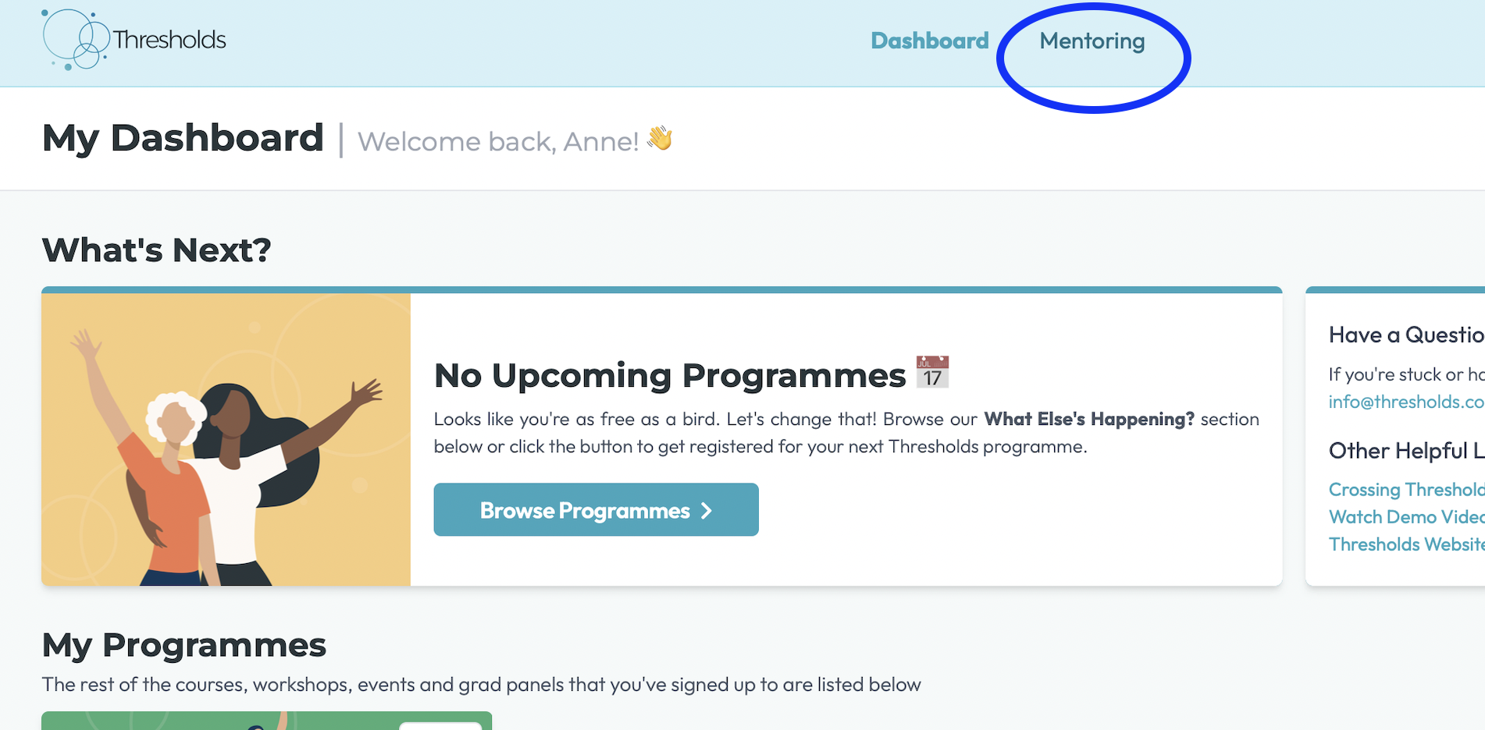
Becoming a mentor

Slide 20
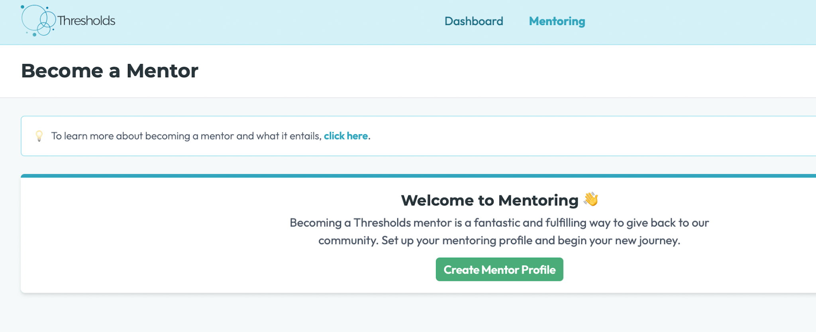
Becoming a mentor

Slide 21
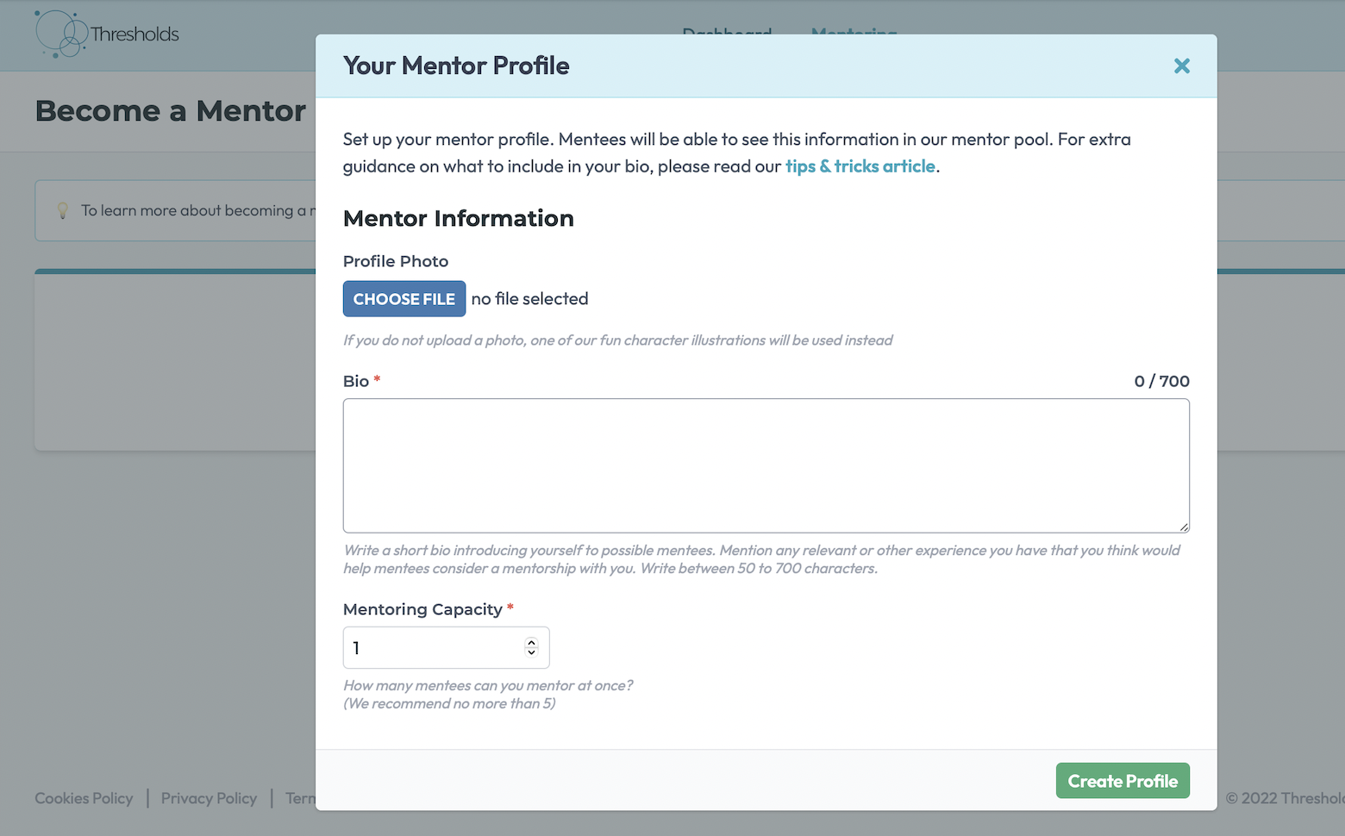
Becoming a mentor

